Slide 1

Chapter 6
Scientific Modeling and Simulation
Computing Science for Science Teaching
การสอนวิทยาศาสตร์ด้วยวิทยาศาสตร์คำนวณ
Author
Department of Science Education
Faculty of Education

Slide 2

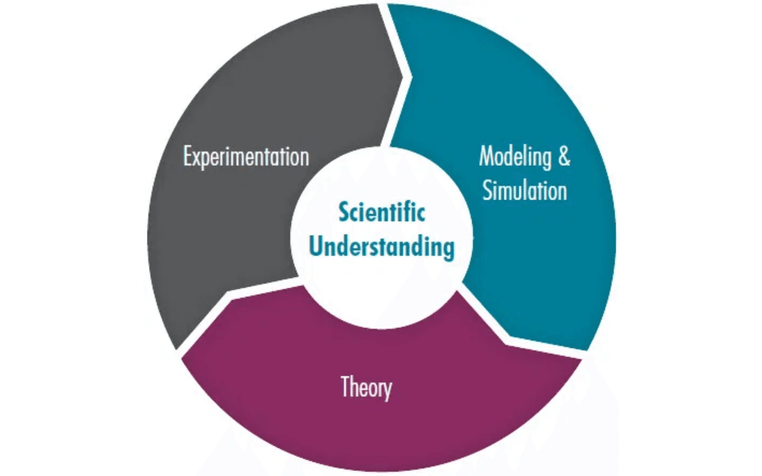
What are Scientific Models?
Scientific models are simplified representations of real-world systems or phenomena. They serve as fundamental tools in every scientific discipline, helping scientists explain, predict, test hypotheses, and communicate complex ideas.
Key Principle:
Models are abstractions, not perfect replicas of reality. They highlight key features and relationships relevant to specific inquiry.
Four Types of Scientific Models:
Conceptual Models:
Mental images or diagrams organizing ideas (e.g., Bohr model of atom, food web diagrams)
Physical Models:
Tangible, scaled versions of real objects (e.g., globe, solar system model, wind tunnel model)
Mathematical Models:
Equations and statistical relationships (e.g., Newton's laws, population growth equations)
Computational Models:
Algorithms in computer programs simulating system behavior (e.g., climate simulations, molecular dynamics)
Common Characteristics
All scientific models share three traits: they are simplifications, constructed for specific purposes, and judged by their ability to explain observed phenomena and make accurate predictions within their defined scope.

Slide 3

The Purpose of Modeling and Simulation in Science
Experimentation in silico (in the computer) allows scientists to conduct experiments where real-world experiments are infeasible due to cost, safety, ethical concerns, or time constraints.
Reason 1
Reason 2
Cost
Safety
Expensive experiments can be simulated computationally, reducing research costs and enabling exploration of
Dangerous experiments can be modeled safely in a computer, protecting researchers and equipment from
multiple scenarios.
hazardous conditions.
Reason 3
Reason 4
Ethical Concerns
Time Constraints
Experiments on humans or animals can be simulated, addressing ethical concerns while still advancing scientific
Long-term processes (evolution, climate change, geological time) can be simulated quickly, compressing years into
knowledge.
seconds.
Scientific Disciplines Using Simulation
Astrophysics:
Modeling stellar evolution, galaxy formation, black hole dynamics
Climate Science:
Predicting future climate under different scenarios
Epidemiology:
Modeling disease spread and evaluating intervention strategies
Molecular Biology:
Simulating protein folding and molecular interactions
Ecology:
Understanding population dynamics and ecosystem interactions
Key Benefits of Modeling
Hypothesis testing in controlled environments
Prediction of future events and unknown outcomes
Understanding complex systems through simplified representations
Optimization of processes and decision-making

Slide 4

Spreadsheets and Basic Simulation
Even basic spreadsheet software can be used to create simple models and run simulations. Spreadsheets provide an intuitive entry point into understanding how models work and how parameters affect outcomes.
Tools: Excel, Google Sheets, LibreOffice Calc
Example 1
Example 2
Population Growth
Radioactive Decay
Model exponential or logistic growth of populations over time.
Simulate half-life calculations and decay curves for radioactive isotopes.
How It Works
How It Works
Create columns for time and population. Use formulas to calculate growth based on birth/death rates. Iterate to simulate multiple
Create columns for time and remaining atoms. Apply decay formula: N(t) = N₀ × (1/2)^(t/t½). Visualize decay curve.
time steps.
Example 3
Example 4
Projectile Motion
Compound Interest
Calculate trajectory of objects under gravity with initial velocity and angle.
Model financial growth with compound interest calculations.
How It Works
How It Works
Create columns for time, horizontal position, and vertical position. Use kinematic equations: x = v₀ₓt, y = v₀ᵧt - ½gt².
Create columns for time periods and balance. Apply formula: A = P(1 + r/n)^(nt). Show how interest compounds.
Advantages of Spreadsheet Modeling
Intuitive and familiar to most users
Good entry point for understanding modeling concepts
Shows how parameters affect outcomes
Accessible for classroom use and student learning
Quick visualization of results through built-in charts
Limitations
Spreadsheets have limited complexity handling, are not suitable for large datasets or complex algorithms, and lack the flexibility needed for sophisticated scientific simulations. For more advanced modeling, programming languages like Python or R are necessary.

Slide 5

Programming Languages for Scientific Simulation
For complex and flexible simulations, programming languages are essential. Python and R have become the dominant choices in scientific computing, offering powerful libraries and communities dedicated to scientific research.
Language 1
Language 2
Python
R
Overview
Overview
Versatile, readable, and widely adopted in scientific computing. Excellent ecosystem of libraries for numerical
Specialized for statistical computing and graphics. Powerful for data analysis, statistical modeling, and visualization
computing, visualization, and machine learning.
of complex datasets.
Key Libraries
Key Libraries
NumPy:
Numerical computing and array operations
ggplot2:
Advanced data visualization
SciPy:
Scientific computing algorithms
dplyr:
Data manipulation
Matplotlib:
Data visualization
Shiny:
Interactive web applications
Mesa:
Agent-based modeling
igraph:
Network analysis
Strengths
Strengths
Beginner-friendly, extensive documentation, large community, integrates with other tools
Statistical focus, publication-quality graphics, reproducible research, strong academic community
Key Strengths of Programming Languages for Simulation
Flexibility:
Design custom models precisely fitting research questions
Scalability:
Handle large datasets and complex algorithms for high-resolution, long-duration simulations
Integration:
Work seamlessly with data analysis, visualization, and machine learning tools
Reproducibility:
Document and share code for transparent, reproducible research
Examples of Complex Simulations
Molecular dynamics simulations in biochemistry
Fluid dynamics modeling for engineering and physics
Ecological systems and population dynamics
Disease spread modeling and epidemiological forecasting
Climate and weather pattern simulations

Slide 6

Specialized Simulation Software
Many scientific disciplines have developed specialized simulation software tailored to their specific needs. These tools provide graphical interfaces, pre-built modules, and domain-specific features that simplify complex simulations.
Software 1
Software 2
COMSOL Multiphysics
GROMACS
Purpose
Purpose
Simulating physics-based systems with coupled physical phenomena
Molecular dynamics simulations in biochemistry and chemistry
Applications
Applications
Fluid dynamics, heat transfer, electromagnetism, structural mechanics
Protein dynamics, drug discovery, molecular interactions
Use Cases
Use Cases
Engineering design, materials science, device optimization
Pharmaceutical research, structural biology, materials discovery
Software 3
Software 4
NetLogo
GIS Software (ArcGIS, QGIS)
Purpose
Purpose
Agent-based modeling for complex systems with many interacting entities
Spatial modeling and analysis of geographic and environmental data
Applications
Applications
Ecology, social sciences, economics, epidemiology
Land use modeling, climate analysis, resource management
Use Cases
Use Cases
Population dynamics, ecosystem modeling, behavioral simulation
Environmental science, geography, urban planning, conservation
Advantages of Specialized Software
Graphical user interfaces reduce learning curve
Pre-built modules for common simulation types
Discipline-specific features and optimizations
Valuable for both research and educational purposes
Important Trade-offs
Cost: Many specialized tools require expensive licenses. Learning Curve: Domain-specific software requires discipline-specific knowledge. Specialization: Tools are optimized for specific applications, limiting flexibility for novel problems.

Slide 7

Assumptions and Simplifications in Models
All scientific models are built upon a set of assumptions and simplifications. These are necessary to make complex systems tractable and computationally manageable, but they also define the model's boundaries and potential inaccuracies.
What Are Assumptions?
Assumptions are statements accepted as true without proof, made to simplify a model. They define what the model considers and what it ignores, directly affecting the model's scope and applicability.
Why Are Simplifications Necessary?
Without simplifications, models would be as complex as reality itself, making them computationally intractable and impossible to understand. Simplifications allow us to focus on the most important factors while ignoring minor details that don't significantly affect outcomes.
Example: Planetary Motion Model
Key Assumptions:
Spherical Planets:
Assumes planets are perfect spheres, ignoring actual irregular shapes and surface features
Point Masses:
Treats planets as point masses located at their centers, simplifying gravitational calculations
Isolated Systems:
Ignores gravitational influence of distant objects and other perturbations
Constant Parameters:
Assumes planetary masses and orbital parameters remain constant over time
Impact: These simplifications make the model mathematically solvable and computationally efficient, but they also limit its accuracy for precise predictions or unusual orbital configurations.
Student Learning Objectives
Identify the explicit and implicit assumptions underlying any model
Consider how assumptions affect model output and predictions
Understand the trade-off between simplicity and accuracy
Recognize the scope and boundaries of model applicability
Question whether assumptions are justified for the research question

Slide 8

Validity, Reliability, and Predictive Power of Models
Critical evaluation is essential for understanding a model's strengths and limitations. Four key dimensions help assess model quality: validity, reliability, predictive power, and generalizability.
Concept 1
Concept 2
Validity
Reliability
Does the model accurately represent the real-world system it is intended to describe?
Is the model's output consistent across multiple runs with the same inputs?
Characteristics
Characteristics
Produces outputs consistent with observed data. Aligns with known scientific principles.
Produces similar results when run multiple times. Indicates robustness of the model.
Evaluation Method
Evaluation Method
Compare model predictions with empirical data. If model consistently fails to predict observed phenomena, its
Run the model repeatedly with identical inputs. Measure variability in outputs. Low variability indicates high
validity is questionable.
reliability.
Concept 3
Concept 4
Predictive Power
Generalizability
How well does the model forecast future events or unknown outcomes?
Can the model's conclusions apply to different contexts or systems beyond the original scope?
Characteristics
Characteristics
Invaluable for scientific planning and decision-making. Can vary across different conditions.
Broader scientific utility. Often limited to specific conditions and contexts.
Evaluation Method
Evaluation Method
Test predictions against future observations. Evaluate accuracy within appropriate scope. Recognize limits of
Test model in different contexts. Identify boundary conditions. Determine where model is and is not applicable.
predictability.
A model might have strong predictive power within a narrow range of conditions but fail when applied more broadly. Understanding these limits prevents over-reliance on model outputs and ensures scientifically valid conclusions.

Slide 9


Uncertainty and Sensitivity Analysis
Scientific models often involve numerous parameters, many of which carry some degree of uncertainty. Understanding how these uncertainties affect model outputs is crucial for drawing valid conclusions.
What is Sensitivity Analysis?
Sensitivity analysis is a technique used to determine how much the model's output changes in response to variations in its input parameters. It helps identify which parameters have the most significant influence on the model's behavior.
Purpose of Sensitivity Analysis:
Identify parameters with most significant influence on model behavior
Determine where further research or data collection is needed
Reduce uncertainty in critical parameters
Understand model robustness and stability
The Sensitivity Analysis Process:
Vary parameters:
Systematically change input parameters within realistic ranges
Measure outputs:
Record how model outputs change with parameter variations
Rank parameters:
Identify which parameters have the strongest effects
Identify uncertainties:
Locate critical parameters requiring more accurate data
Applications
Climate modeling: Understanding sensitivity to CO₂ levels and solar radiation
Epidemiological models: Evaluating sensitivity to transmission rates and intervention effectiveness
Economic forecasting: Testing sensitivity to interest rates and market conditions
Engineering design: Optimizing designs based on parameter sensitivity

Slide 10

Critical Evaluation of Scientific Models
Scientific models are powerful but imperfect tools. Critical evaluation helps us appreciate models' strengths while understanding their limitations, fostering nuanced understanding of scientific knowledge construction.
1
Identify Assumptions
What simplifications and assumptions were made in the model?
List explicit assumptions stated in model documentation
Identify implicit assumptions (what the model ignores or assumes constant)
Consider whether assumptions are justified for the research question
2
Test Validity
Does the model accurately represent the real-world system?
Compare model predictions with observed empirical data
Check alignment with known scientific principles
Evaluate consistency across different test cases
3
Assess Limitations
When and where does the model fail or become unreliable?
Identify conditions where model predictions are less accurate
Determine boundary conditions and scope limitations
Recognize edge cases and exceptional scenarios
4
Evaluate Uncertainty
How confident are we in the model's predictions?
Identify sources of uncertainty (parameters, initial conditions, structure)
Perform sensitivity analysis to find critical parameters
Quantify confidence intervals and prediction ranges
5
Consider Scope
Where is the model applicable and where should it not be used?
Define the domain of applicability (systems, conditions, scales)
Recognize when extrapolation beyond scope is inappropriate
Understand generalizability to different contexts
Student Learning Outcomes
Develop critical thinking skills about model limitations and appropriate use
Appreciate models as tools with specific purposes and boundaries
Foster nuanced understanding of scientific knowledge construction
Recognize when models are appropriate and when they are not
Real-World Example: Weather Forecasting Models
Accuracy: Highly accurate for 3-5 days ahead. Limitations: Become unreliable beyond 10 days due to sensitivity to initial conditions and model structure. Scope: Apply to specific geographic regions; global patterns differ from local predictions. Uncertainty: Depends on computational power, data quality, and atmospheric complexity. This example illustrates how even sophisticated models have clear boundaries and must be evaluated critically before use.

Slide 11

Practical Applications - Case Studies
Scientific modeling is not merely theoretical—it directly addresses real-world challenges. These three case studies demonstrate how computational models inform critical decisions in climate science, public health, and environmental conservation.
Case Study 1: Climate Modeling
Understanding and Predicting Global Climate Change
Purpose
Predict future climate under different emission scenarios and evaluate the effectiveness of mitigation strategies
Models Used
General Circulation Models (GCMs) that simulate atmosphere, ocean, ice, and land surface interactions
Key Inputs
Atmospheric composition (CO₂, methane, aerosols)
Solar radiation and albedo
Ocean currents and heat transport
Land use and vegetation patterns
Model Outputs
Temperature changes (global and regional)
Precipitation patterns and extremes
Sea level rise projections
Ecosystem impacts and species migration
Real-World Impact
Climate models inform international climate agreements (Paris Agreement), national climate policies, and investment decisions in renewable energy and infrastructure adaptation.
Case Study 2: Epidemiological Modeling
Predicting Disease Spread and Evaluating Public Health Interventions
Purpose
Predict disease transmission dynamics and assess the effectiveness of interventions (vaccination, quarantine, social distancing)
Models Used
SEIR models (Susceptible-Exposed-Infected-Recovered) and agent-based models that track disease progression through populations
Key Inputs
Disease transmission rates (β)
Incubation and recovery periods
Population demographics and contact patterns
Intervention strategies and compliance rates
Model Outputs
Infection curves and epidemic peaks
Timing and magnitude of outbreaks
Intervention effectiveness estimates
Healthcare resource requirements
Real-World Impact
Epidemiological models guide public health policy decisions, hospital preparedness planning, and resource allocation during disease outbreaks and pandemics.
Case Study 3: Ecological Modeling
Understanding Population Dynamics and Ecosystem Interactions
Purpose
Understand population dynamics, predict ecosystem responses to environmental changes, and evaluate conservation strategies
Models Used
Agent-based models, differential equations (Lotka-Volterra), and network models representing species interactions
Key Inputs
Birth and death rates for each species
Predator-prey interaction strengths
Environmental factors (temperature, rainfall, habitat)
Human impacts (hunting, habitat loss, pollution)
Model Outputs
Population trajectories and stability
Ecosystem resilience and tipping points
Biodiversity impacts of environmental changes
Extinction risk assessments
Real-World Impact
Ecological models inform conservation strategies, protected area design, species reintroduction programs, and management of endangered species and invasive species control.

Slide 12

From Models to Understanding
Key Takeaways
1
2
Scientific models are essential tools for understanding complex systems and phenomena that are difficult or impossible to study directly.
Multiple approaches exist for modeling and simulation, each with distinct strengths and limitations suited to different scientific questions.
3
4
Critical evaluation of models prevents misinterpretation, misuse, and over-reliance on computational outputs.
Computational literacy enables students to engage meaningfully with contemporary scientific practice and research.
Educational Impact
Computational Thinking Skills:
Teaching modeling and simulation develops students' ability to decompose complex problems, recognize patterns, and design algorithms
Systems Thinking:
Students learn to understand how components interact within complex systems and how changes propagate through systems
Critical Evaluation:
Students develop the ability to assess model validity, recognize limitations, and think critically about computational results
Scientific Methodology:
Modeling reinforces the iterative nature of scientific inquiry: hypothesize, test, refine, and repeat
Looking Ahead
Chapter 7: Information Management and Digital Literacy for Science Teachers explores how to organize, manage, and protect scientific data effectively. As computational tools generate increasingly large datasets, understanding data management practices becomes essential for responsible science education and research.
Integrate modeling and simulation into your science curriculum to prepare students for contemporary scientific practice and develop their computational thinking capabilities.

